Slide 1
Job Tracker Application
CS-545-WS
Final Project Presentation
Parth Parab
Varsha Raghavendra
Prateek Jani
Sanket Patidar
Manas Kulkarni

Slide 2
What is our application?
In today’s ever changing environment, applying for relevant jobs and internships has become an everyday task for students and recent graduates. Most application and interview processes are now online thus making it very essential to keep track and note of the various updates to the applications sent via email. According to a survey we conducted, students almost apply to 10+ jobs in a single day. We thought it would be helpful to build an app that caters to these needs.
We have created an application that lets users track their job applications while it’s in the various stages of process namely after the user has “applied”, it moves on to “interview” stage that might either be Hackerrank assessments, HireVues, 30min phone interviews or an invite to the superday. The application is then moved to either a “reject” or “accept” column where the final offers or rejection emails are sent.

Slide 3
Targeted E - Efficiency
Present only most important information. Work on smooth direct navigation. Interaction style should minimize actions required.
The primary E we are focusing on improving is “efficient”. The idea is to present only the most important information in an efficient concise manner.
For example speed to do the task, higher satisfaction, less errors
Our efficiency is measured using a simple comparison of popular apps like notes/Excel used to track applications vs our UI with respect to these parameter:
Speed of operation
Ease of navigation and interactivity
Organization of user data in the design

Slide 4

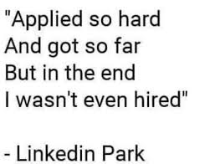
Target Population
Students, recent Graduates and anybody applying rigorously to land that dream job or internship

Slide 5
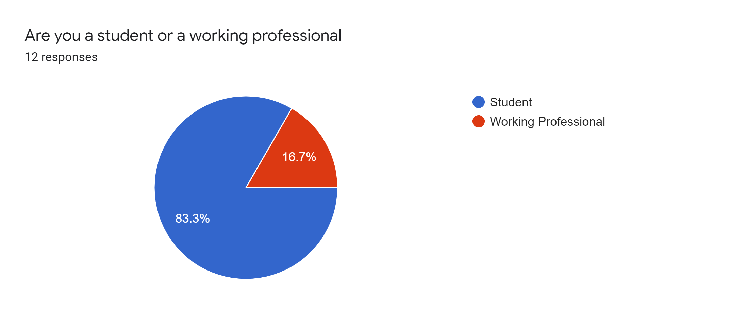
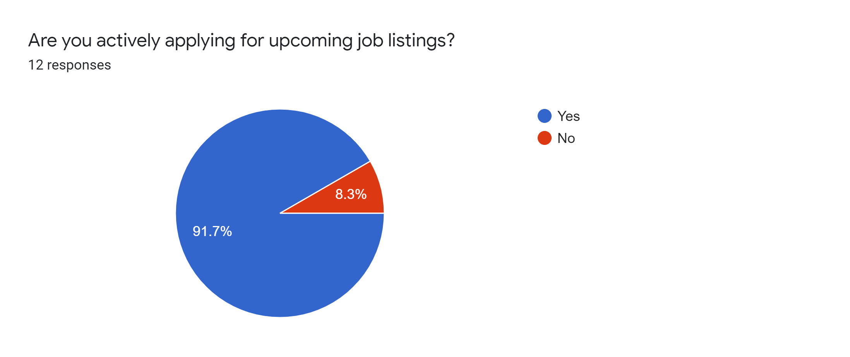
Preliminary User Survey Data
We conducted a survey with a Google form to fetch data and gain insights into user need for our solution. We collected information from 12 people. We saw the following results:

Slide 6
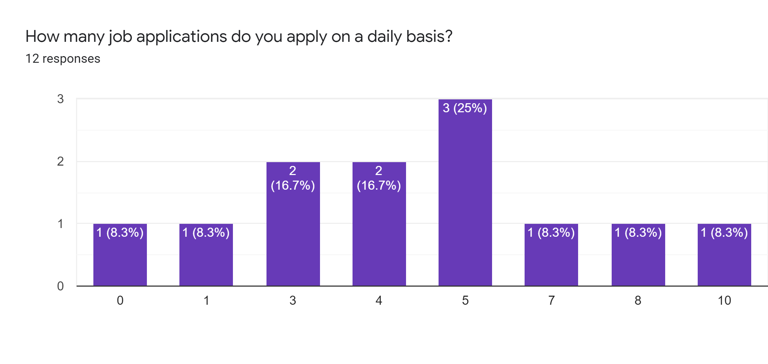
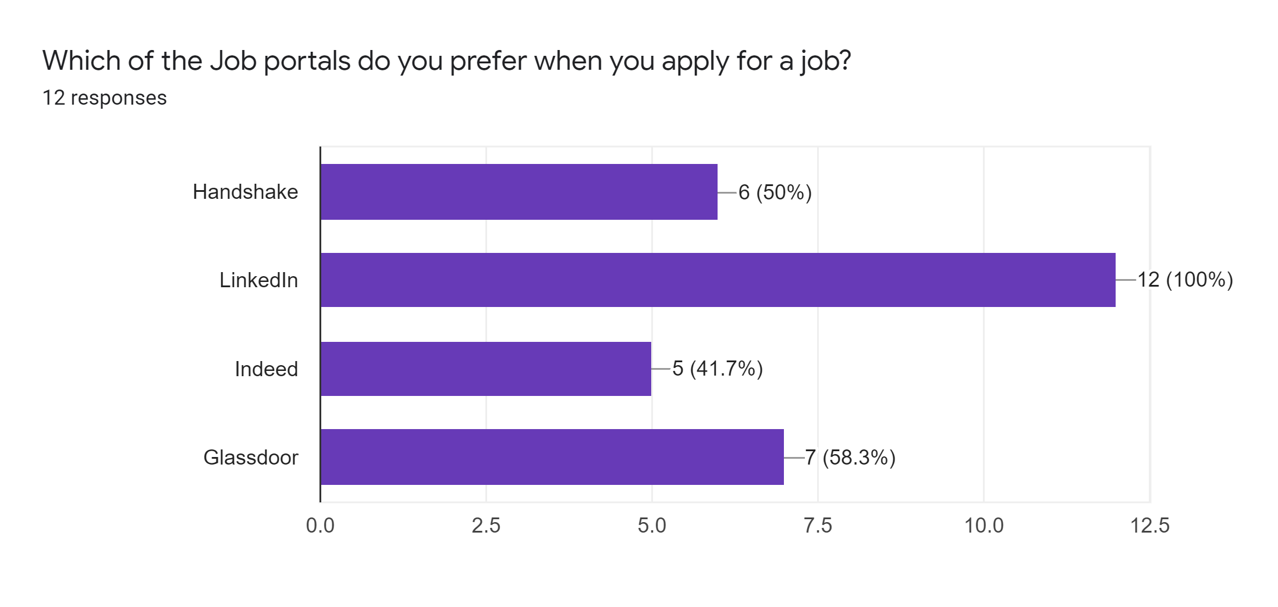
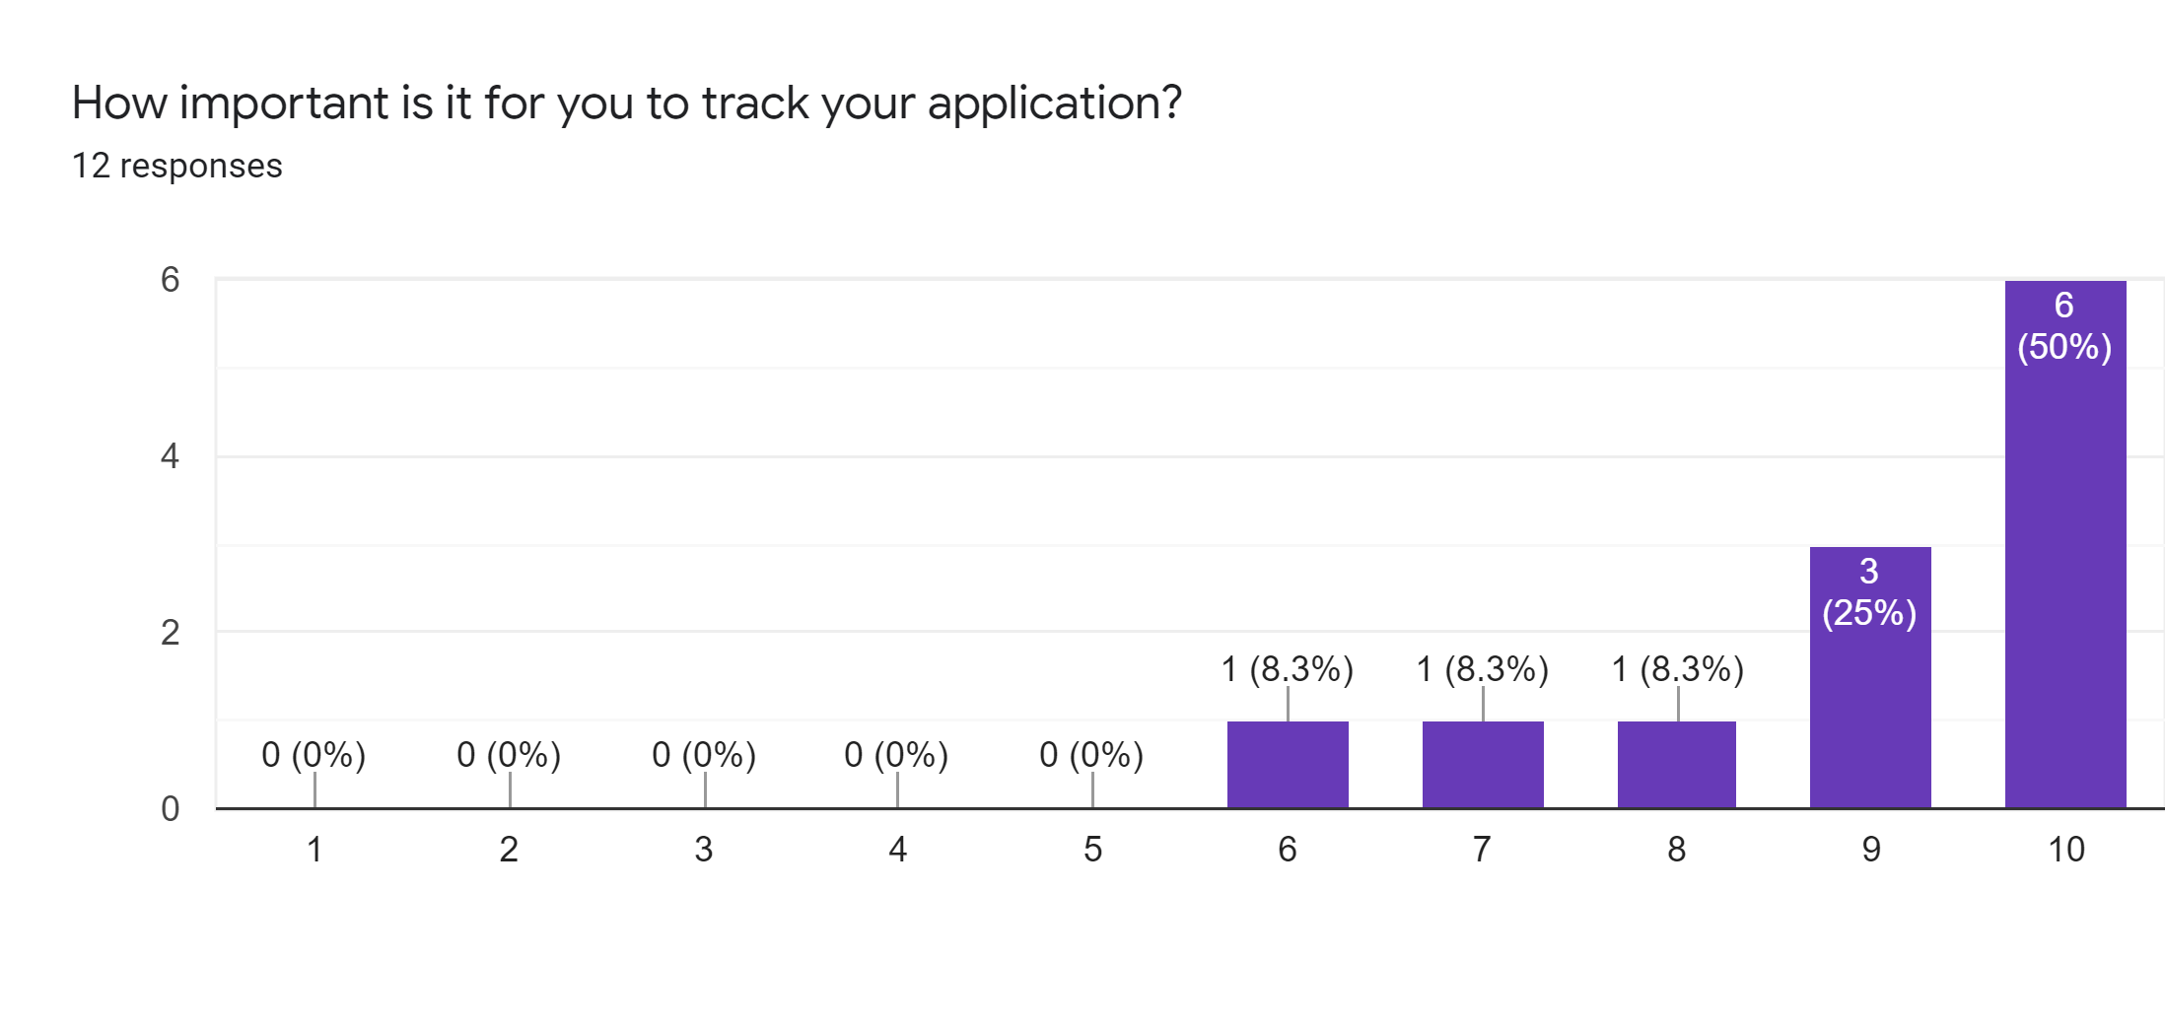
Preliminary User Survey Data

Slide 7
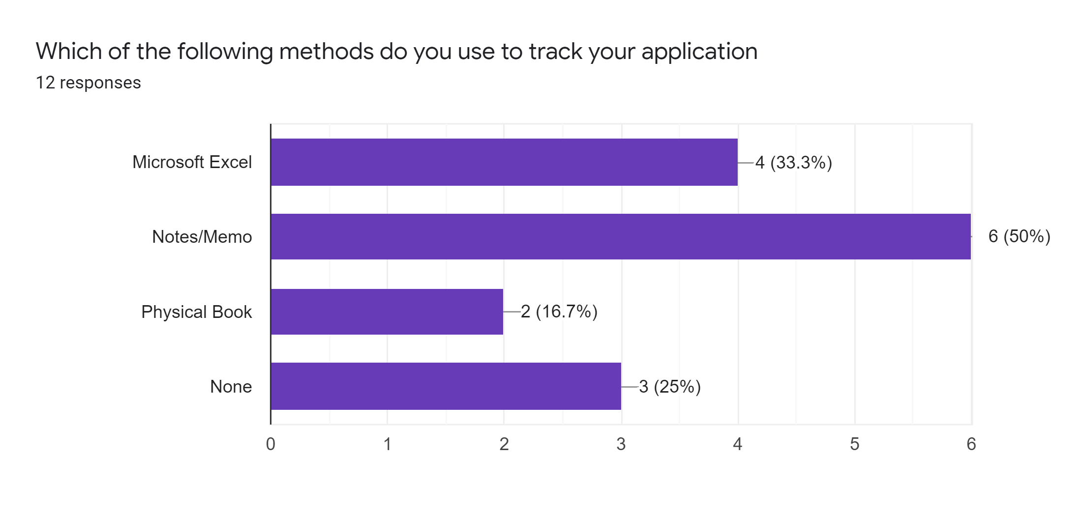
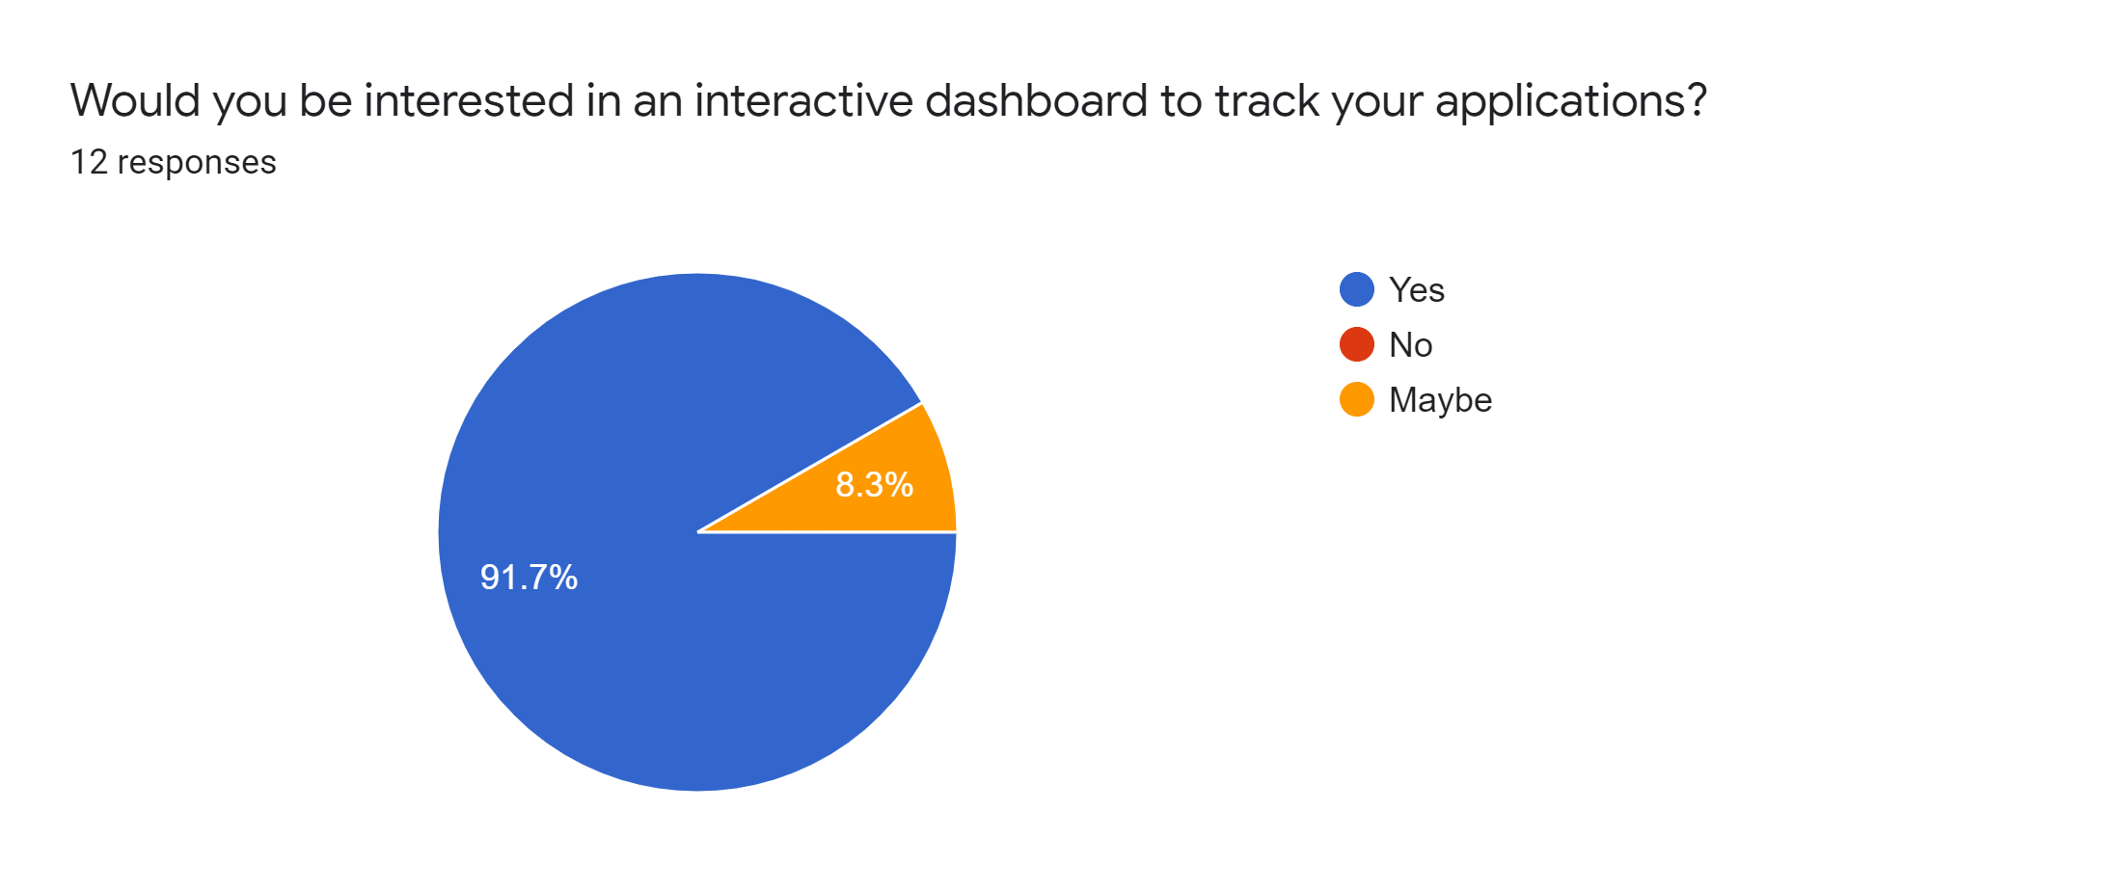
Preliminary User Survey Data

Slide 8
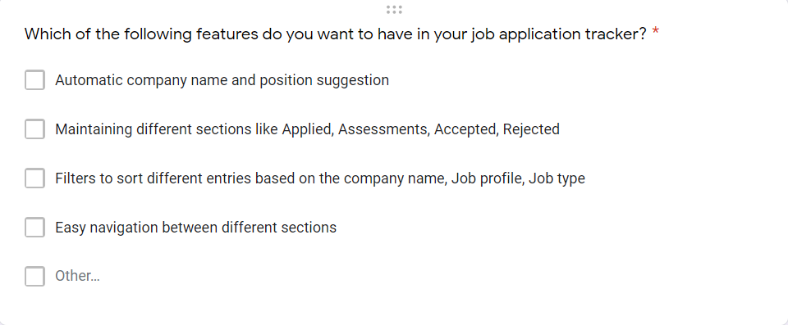
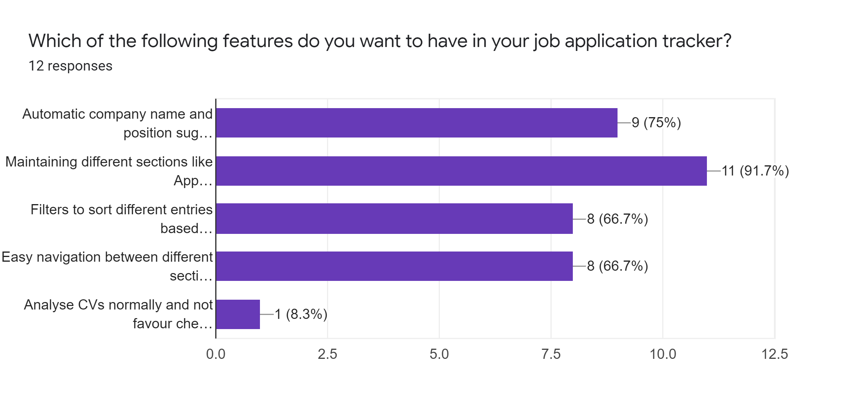
Preliminary User Survey Data
To decide on necessary features, we asked our potential users this question and got the following responses:

Slide 9
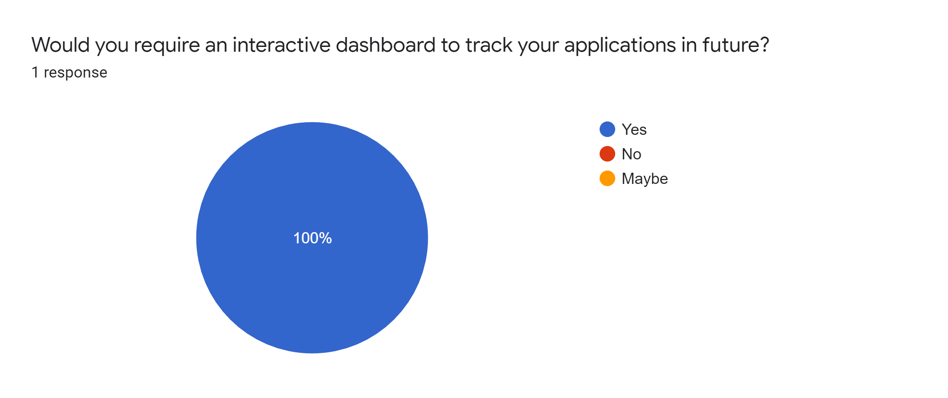
Preliminary User Survey Data
Even those that said weren’t applying at the moment still said they’d want an application like this in the future

Slide 10
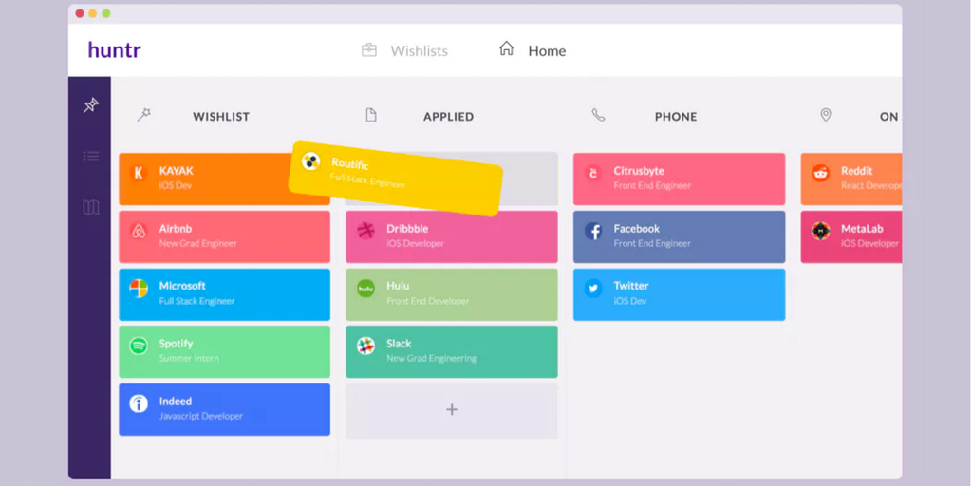
Industry Overview and Competition
One of our major competitions and inspirations for the idea was Huntr.co, a one page job tracker that helps job seekers view and track all their applications in one place. But even though it provides an almost perfect UI with drag and drop features, wishlists and links to job applications, mappings of where the job is located and company logos, it is a paid service. It also bores the user by providing much too many features than necessary. Simplicity is the key here.

Slide 11
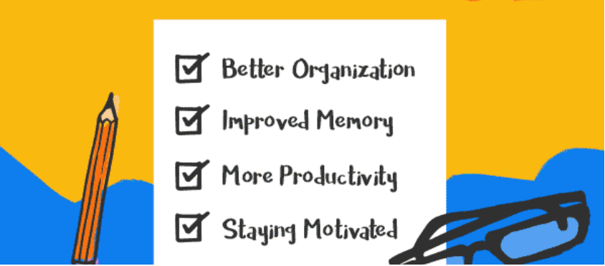
Industry Data
Data from industry research we conducted proved that there is a high demand for to-do lists and trackers for everyday human activities. When it comes to HCI concepts like Laws of Simplicity for such applications, ORGANIZE plays a huge role. Hence to summarize, industry data as seen from various to-do list type single page applications like Huntr.co, todoist, to-do.microsoft.com, jobtrackable.com tells us the benefits and the reasons for the need of more such simple organized applications:
1. Organization - Having a list of all your tasks will allow you to sit down and make a plan. One study showed that fifteen minutes spent planning could save an hour of execution time!
2. Improved Memory - Act as useful external memory aid that give you permission to forget. The average person's short-term memory can only hold 7 pieces of information for about 30 seconds.
3. Productivity - Will help you focus your attention on the most important task of the moment

Slide 12
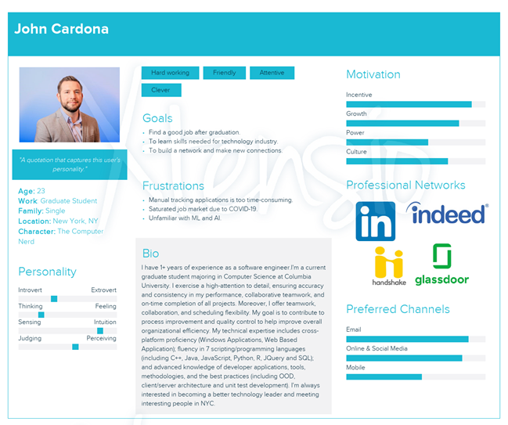
User Persona
John Cardona is a graduate student pursuing a degree in computer science from Columbia University in New York City. He is aspiring to become a software engineer and work in a technology company on challenging projects. He is in his final year and has started applying to full time jobs actively for after graduation. He is also however working two jobs part-time. He applies on both LinkedIn and his university job portal Handshake but often loses track of the progress of his applications given his busy schedule. John creates an account on Jist and starts to add incomplete jobs, applied jobs and details for applications that have gone to the first stage, deadlines to submit his hackerrank assessments and interviews lined up on the dashboard and the easy navigation and detailed information stored helps him track his progress. This now helps him relax and focus on his other work while still applying rigorously. He never forgets deadlines or upcoming assessments as well. Time and resources are spared, and he is now soon hoping to land a job in his dream city of New York and be able to make an impact in the world of AI, Software and Machine Learning.

Slide 13
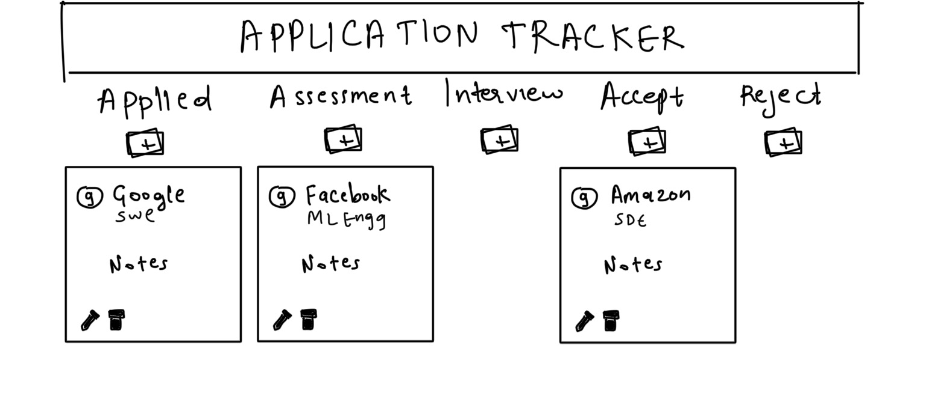
First Design (On Paper)
Our first paper design was very basic with 5 columns
It had just edit and delete buttons at the footer of the card and had no header information.
We also had the rest of the job details on notes and had thought of customizing detail presented in every job status column like assessment deadline or interview dates would be an added field while editing the job card. We also had drag and drop as a feature planned initially to move the job cards

Slide 14
User Feedback - First Design
No need for separate assessment and interview columns as both information could be squeezed into a single all-stage interview process that makes it easier to track
Using drag and drop features would result in slower time to reach target thus causing frustration
Editable notes and details to concisely store all application related information
Color coded columns (Reject with red)
Add about us and help sections so users will not have any problem navigating

Slide 15
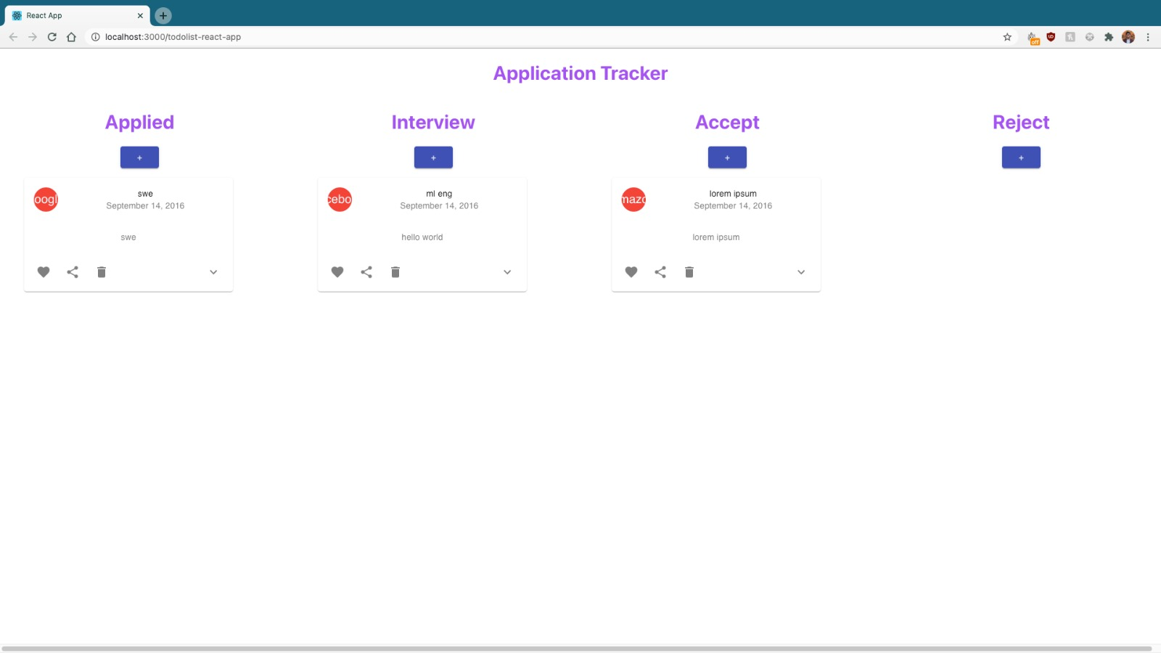
Second Design (On Wireframe)
Our second medium fidelity design was a wireframe representation of our application.
Our wireframe model still did not incorporate color codes but did heed to the rest of the ideas
It also had corrected Applied, Interview, Accept and Reject columns with concise and small job cards with like, share and delete buttons

Slide 16
User Feedback - Second Design
The like and share are redundant and would not benefit job seekers as the portal is personalized and is mostly accessed by one person who would prefer to keep details such as number of applied jobs, accepts and rejects confidential.
The edit was missed out and that was clearly notified to us
The delete and edit could be placed together for better accessibility
The drag and drop feature was dropped but however it was suggested that we could still make it possible for users to move their job cards to another column by buttons which were missing in this design
Add about us and help sections so users will not have any problem navigating

Slide 17
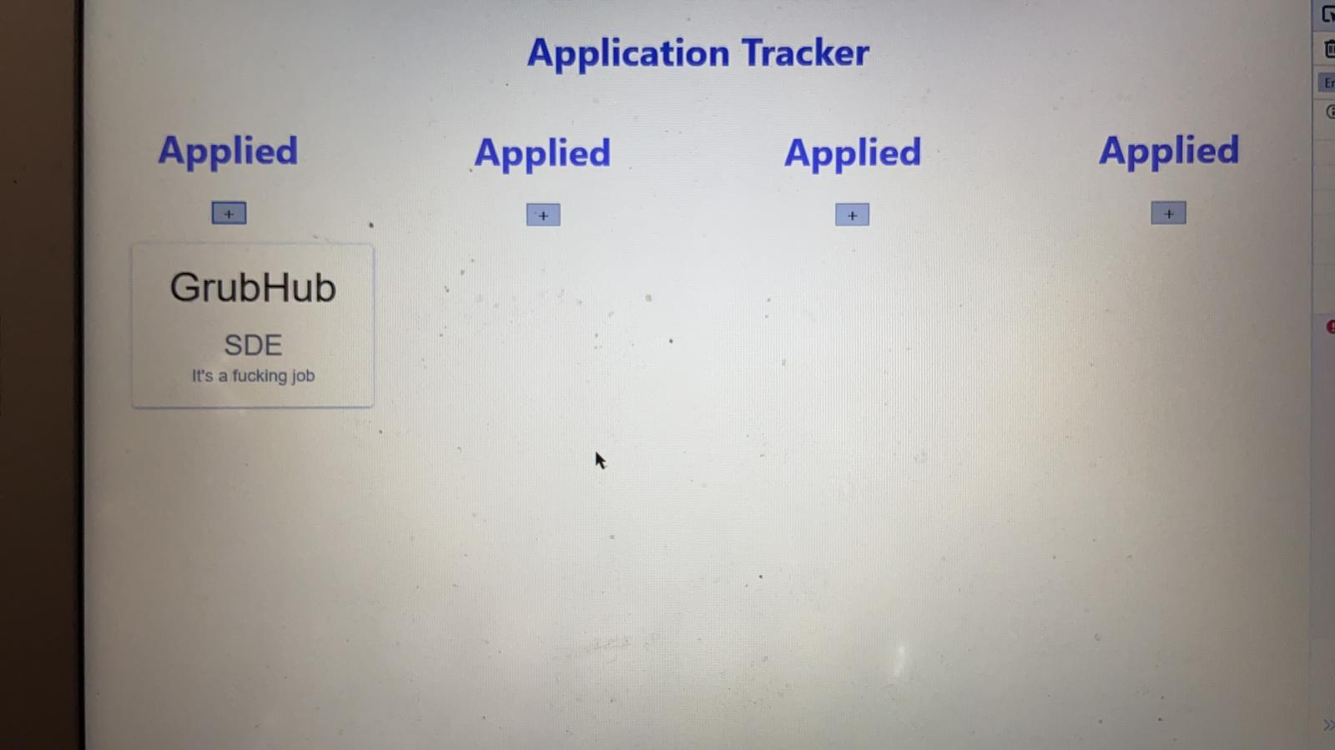
Third Design (1st Iteration high-fidelity)
In this design we started code Implementation of initial frame by defining the basic format
Also built the Implementation of one card that fits all criteria
We had four columns with same name initially and features with just + that adds a job card
This was done using basic HTML (No CSS)

Slide 18
User Feedback - Third Design
The structure is perfect for user interaction with UI
Seamlessly presented all information in one page with a good font size
Same card sizes makes it easier to access same and all information together in every column
Good start but a long way to go
Needs a header and help options

Slide 19
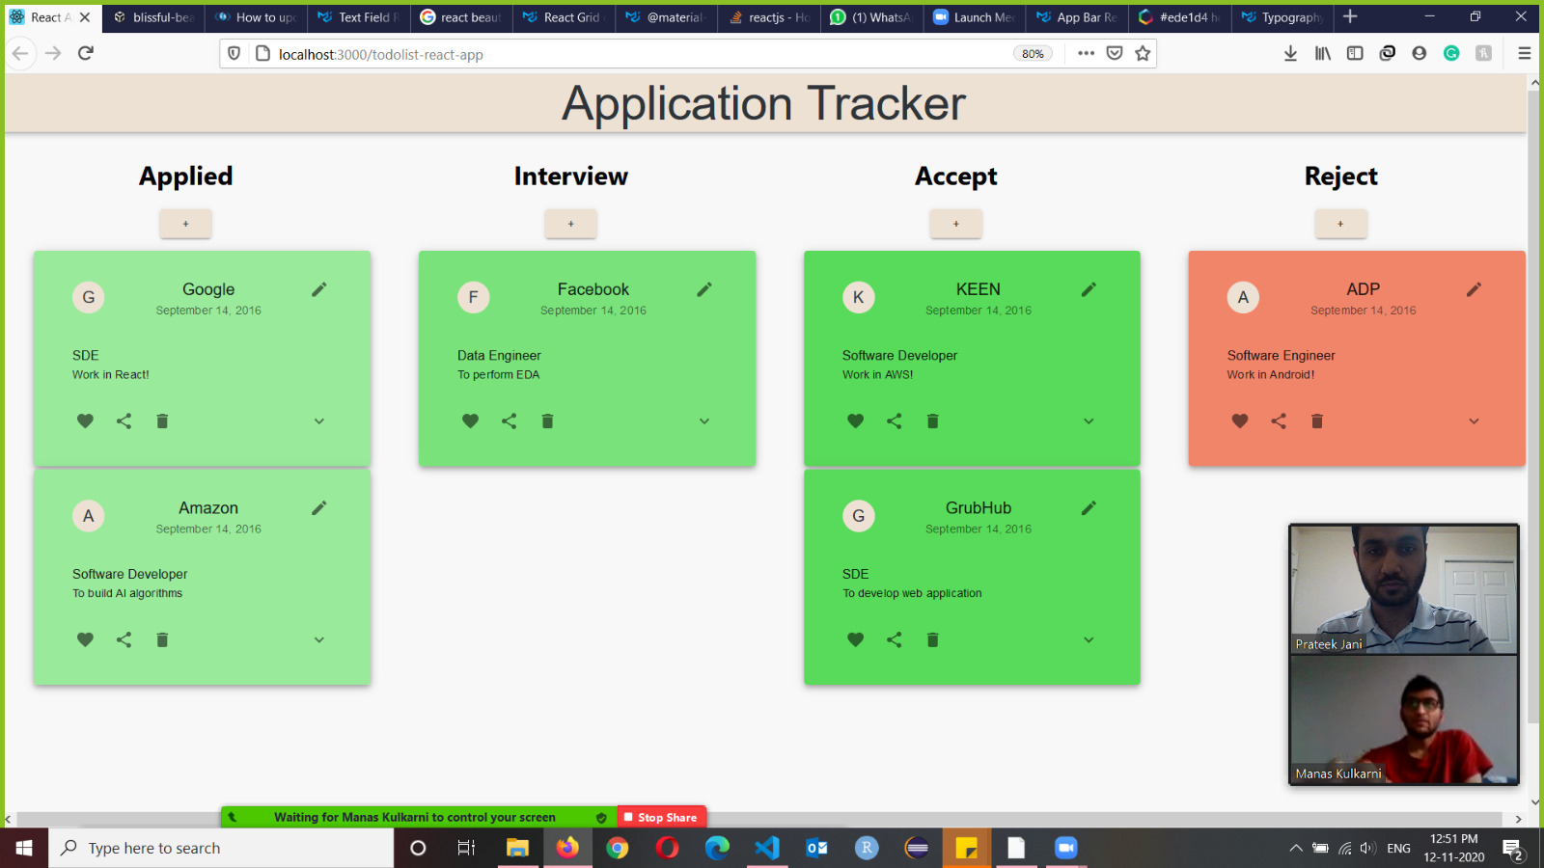
Fourth Design (2nd iteration)
In this design, we completed a lot of what our users had asked us to work on
The edit button on top
The applied date
The header with our title
Color codes
Circular slot that inserts automatically the first letter of the company name

Slide 20
User Feedback - Fourth Design
Perfect look and feel of the application comes into life
The color codes are accurate even with respect to accessibility
The like, share and delete should still go and be replaced with the buttons to move the cards. Delete moves next to edit
Edit field Job application link should be able to accomodate all types of links (even ones to assessments or Zoom interviews)
Nicer looking font on header
Give application a nice attractive name!
About us and help page still missing

Slide 21
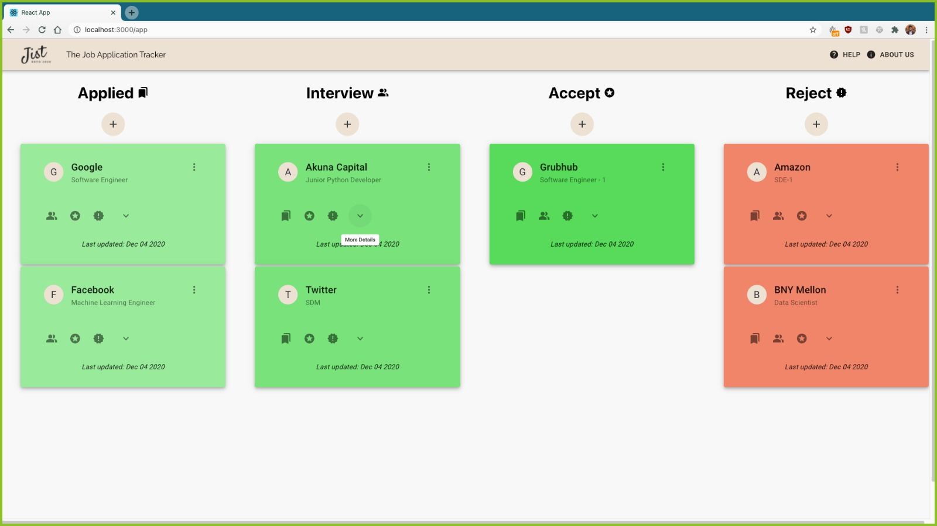
Final Design

Slide 22
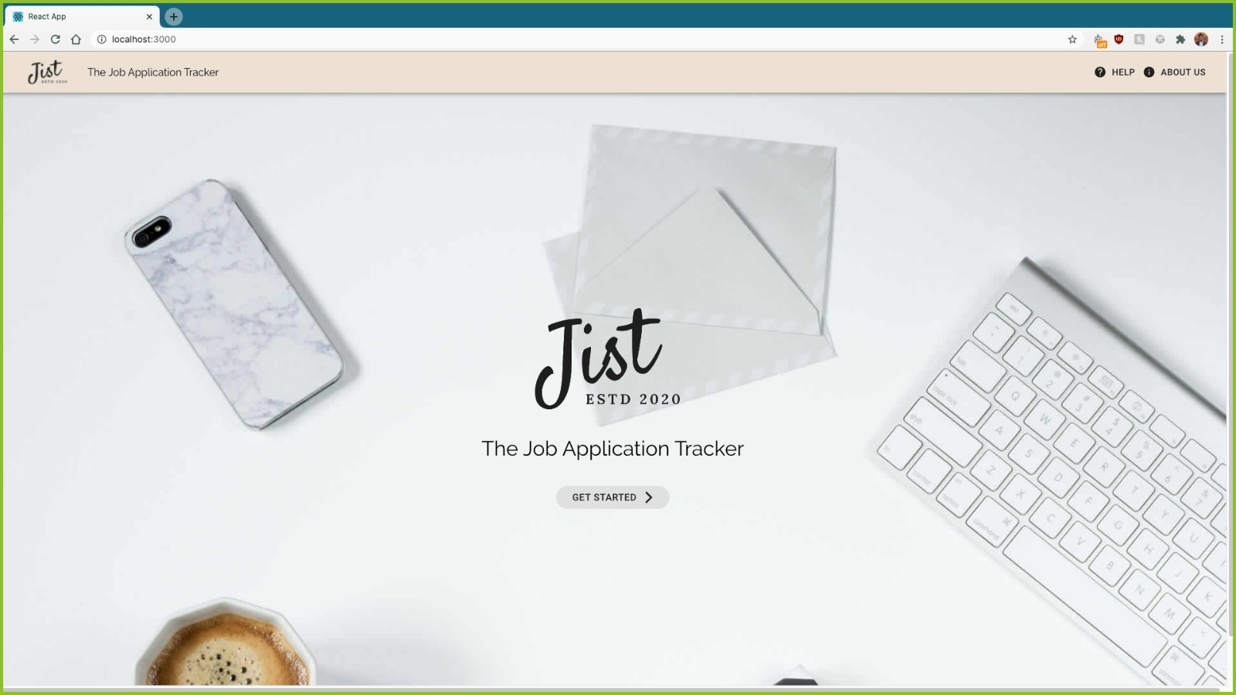
Demo - Landing Page
https://github.com/parthxparab/CS-545-Project

Slide 23
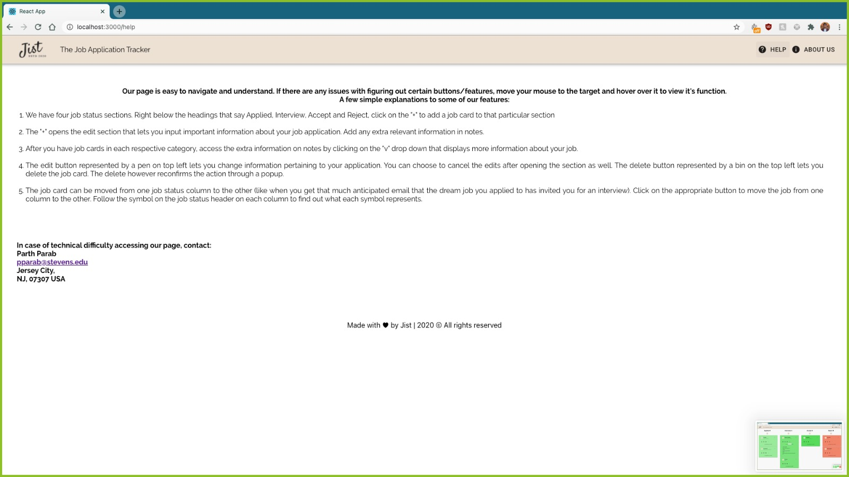
Demo - Help Section

Slide 24
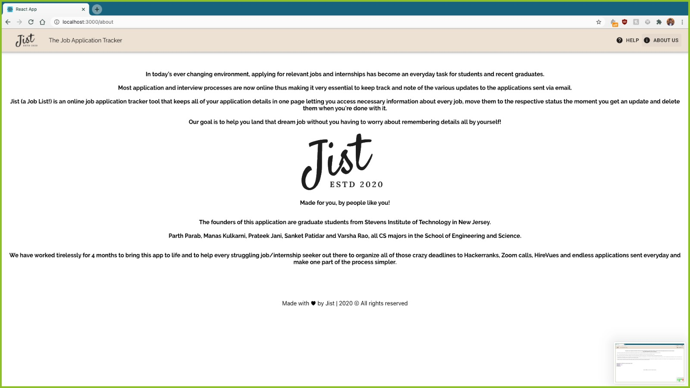
Demo - About Us

Slide 25
Demo - Main Page

Slide 26
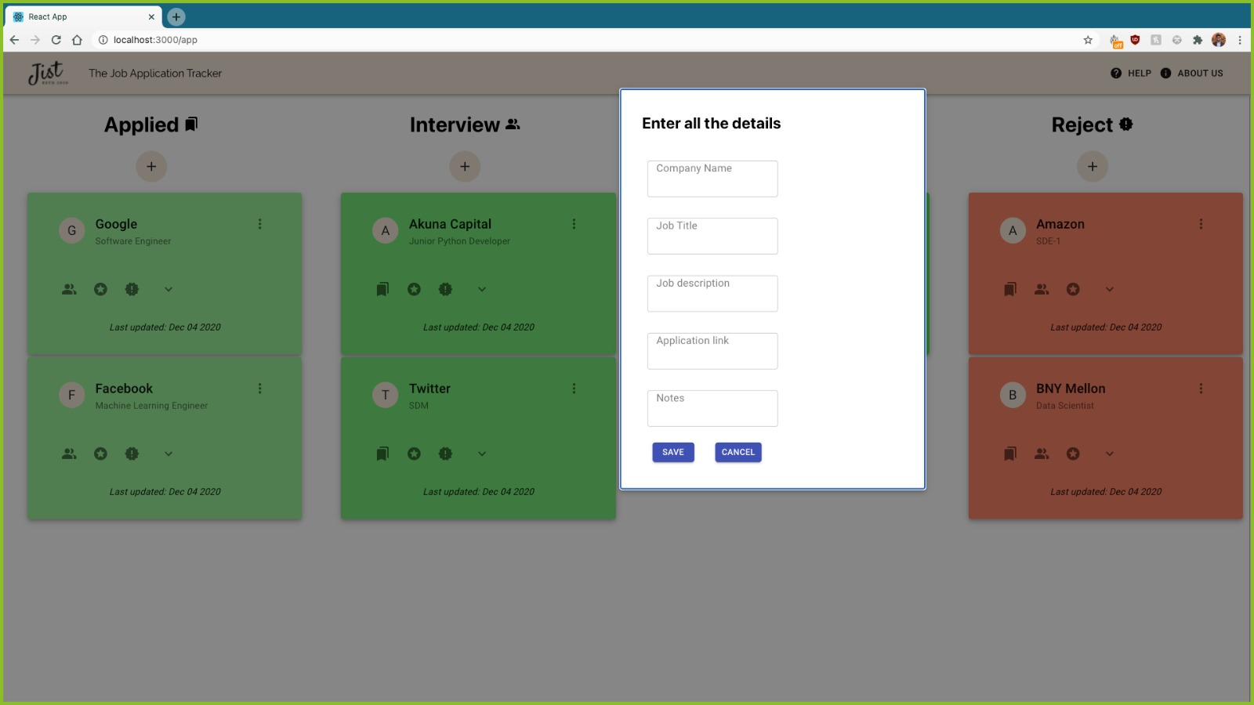
Demo - Add new job

Slide 27
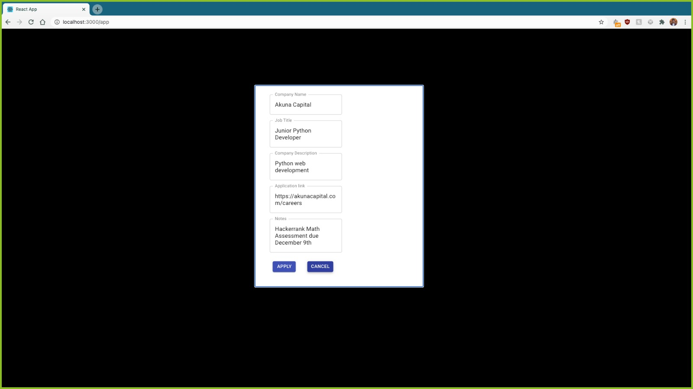
Demo - Edit Job Details

Slide 28
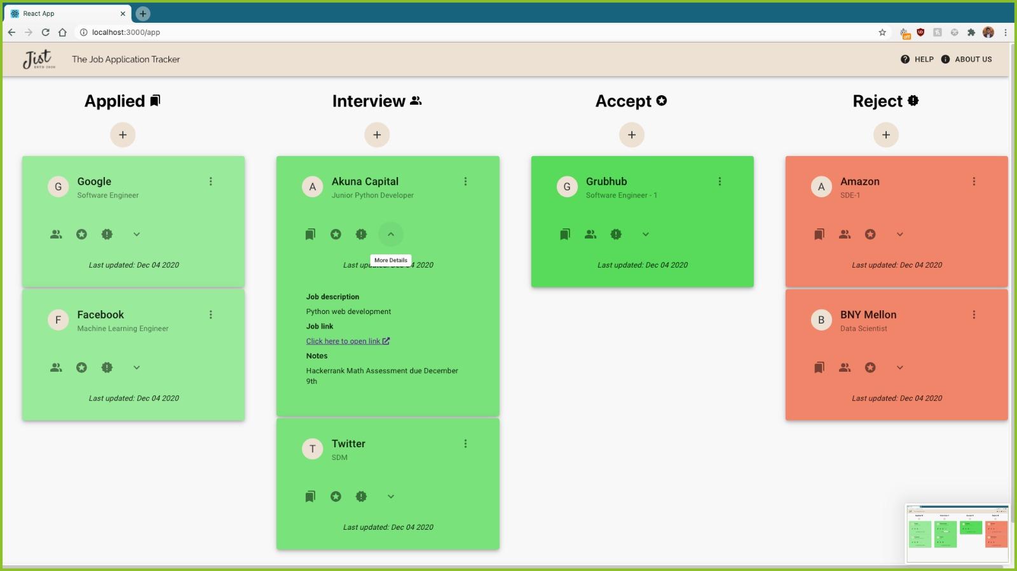
Demo - More Details Drop Down

Slide 29
Up to PAR? - YES!
PAR stands for Perception, Attention, and Retention. PAR focuses on psychological issues of the interface like how the user perceives and interacts with the interface (Perception), how the user notices existing features in the interface (Attention), and how well the user retains whatever he/she has learned from the interaction with the system (Retention). Our Job Application Tracker is up to PAR as we have designed a very intuitive user interface that the user can perceive easily and can clearly distinguish between all the functionalities of the interface. I also believe that due to such a clear and simple design the user will be able to retain most of the interactions with our project.
Perception - The user interface would be seamless with job card move button features, ability to edit and delete and keep track of all their applications on a one page portal, ability to view all important information as a drop down and edit on the same page and also to add links to the portal.
Attention - We have a notes section that lets users customize what they need to remember along with color coded job sections (red for reject and green for the rest)
Retention - The color codes and font style helps users retain the information and easy one page access lets them get back to it in a jiffy (no account creation or log in)

Slide 30
Laws of Simplicity Review
ORGANIZE
From before we started our goal was to organize information concisely in a way that lets users access all information in a smaller space. The features catering to this are:
Separate job status columns for various stages of application
Easy switch to another column when job status changes
Everything in one page!
Because of our goal of concise organization, we also end up adhering to REDUCE Law of Simplicity by:
Drop down with more information in each job card
Symbols to represent certain actions and sections
Hover feature that lets users learn what these buttons do

Slide 31
Accessibility Evaluation
Following a few accessibility self check pointers from WCAG we saw that our website was mostly accessible:
The “v” drop down helps unclutter the page also making non-essential details still easily accessible
One header and header tab that also has access to the “About Us” and “Help” sections
Font Size - The page already has a reasonable font size as recommended
We simplified and kept a text-only platform with no images, flashy content or videos
We also sent our app through an accessibility test by Tota11y and it passed all parameters with flying colors

Slide 32
Heuristic Evaluation
User control and freedom - Edit, delete and move buttons ensure user control of data
Recognition rather than recall - Ability to access all information about each job application in one job card
Match between system and the real world - Most terms used like applied, interview, accept/reject with simple edit fields
Flexibility and efficiency of use - Buttons to move job cards and notes section for flexibility to add information of any format
Aesthetic and minimalist design - One page application with same edit and column features
Help and documentation - help and about us sections along with hover that tells users what they’re looking at

Slide 33
User Feedback - Final Design
The users were very happy with our final design and said that they would definitely use it to track their job applications
Very organized data and easier navigation (not too many features)
Buttons >> drag and drop of job cards
Color coded and presented well
Could have been more engaging (reminders of upcoming assessments/interviews, company logos, prioritizing with respect to deadline or choice, etc)
The inputs we could add are plenty and hence the final user review gave us a lot of insight into our future scope

Slide 34
Our Target E - Did we hit it?
From the start, our goal was to make changes to the presentation and increase the overall efficiency of the application. With the features given below I believe we did manage to reach our target E - efficiency
Speed of operation - We increased our speed of operation by using buttons to move job cards over drag and drop features in most other job application trackers
Ease of navigation and interactivity - The simple edit and delete buttons help users put all information in one card, use a drop down to view more details about their application and also choose to delete eventually when needed
Organization of user data in the design - The data is organized concisely in the job card with the most important information like company name, position and date applied is at the top and the rest of the information is available at the click of a drop down button

Slide 35
Future Work
We understand that given more time and resources a lot more features could have been added
Edit fields for each column different than the rest
Automatic upload of company logo after user chooses company name from dropdown list. Keep first letter of name if not in list
Mapping of the job location on a separate map tab on the header
Set reminders for upcoming deadlines of assessments or interviews
A separate field to add recruiter/manager/employee names, numbers and emails (other than notes)
Have account creation that signs in with Gmail/Facebook

Slide 36
References
[1] https://www.boia.org/blog/5-quick-ways-to-self-check-the-accessibility-of-a-website
[2] Benefits of an Online to-do list and Task Manager
[3] https://www.nngroup.com/articles/ten-usability-heuristics/
[4] https://github.com/atlassian/react-beautiful-dnd
[5] https://medium.com/better-programming/creating-a-simple-app-with-react-js-f6aa88998952
[6] https://www.w3.org/WAI/test-evaluate/preliminary/
[7] https://codesandbox.io/s/blissful-beaver-vv5jo?file=/src/Card.jsx
[8] Our Google Form: https://forms.gle/bFJQKG3FfjuK2zfy6

Slide 37
Thank you!

